Slide 1
Paper Title SAWE Paper XXXX
Author Name Author role, employer or organization
XXth SAWE International Conference

Slide 2
Page Format
Page size 16x9
White background
Content must NOT obscure header or footer
Header - defined in slide master, contains:
SAWE logo at left
Page title - font Calibri, point size 30, centered horizontally on page, color black - All Words Capitalized
Line border - 2.25pt wide, gold color R230 G188 B27
Footer - defined in slide master, contains:
Proprietary and export control text - font Calibri, point size 9, centered horizontally on page, color 85% black
Page number at right - font Calibri, point size 9, color 85% black

Slide 3
Body Text Format
Font Calibri, point size 16 to 36, color black, capitalize the first word
Bullets round, color black (bullets are not required)
Avoid wrapping text over multiple lines (2 lines is acceptable)
No more than 5-6 bullets in a list
Use bold or underline or color for emphasis, Avoid italics and ALL CAPITALS
Indent sub-bullets
Sub-element lists should use smaller point size
Sub-element lists should contain at least two entries

Slide 4
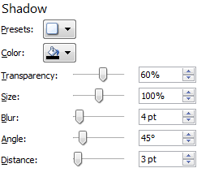
Takeaway Box Format
Highlights the message of visually busy or full slides
Not required on all slides
Avoid wrapping text in the box
Text box format:
Centered horizontally at bottom of page (do not cover footer)
Font Calibri, bold, point size 16 to 24, color black, first word capitalized
Line border - 3/4pt wide, color black
Box fill - gold color R230 G188 B27
Outer shadow, details at right:
Consider including a takeaway message box

Slide 5
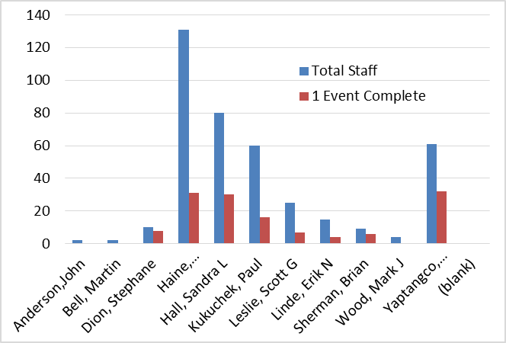
Chart Format
Charts must be legible
Keep charts simple
Include only data relevant to topic
Include axis and data labels
Text must be readable
Colors must be distinct
Chart format:
Line border - 3/4pt wide, color black
Outer shadow, details on “Takeaway Box Format” page
Include text on page to interpret the chart message

Slide 6
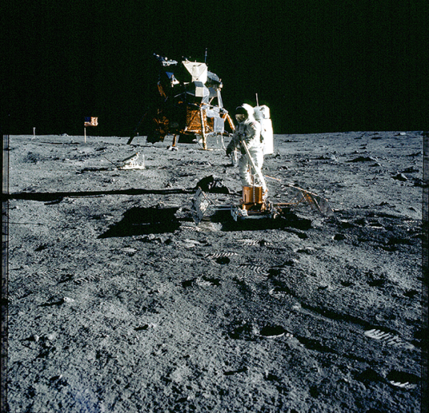
Picture Format
Picture format:
Line border - 3/4pt wide, color black
Outer shadow, details on “Takeaway Box Format” page
Text may overlay pictures
Must be readable
Font Calibri, bold, point size 14 to 24
Overlay text must be readable

Slide 7
Content
One message per slide
Text should be short and to the point
Keep the visuals simple
Use charts, pictures and graphical elements to help communicate the message
Maintain a consistent format
Avoid slide transitions and animations unless they clarify the message
Content must NOT obscure header or footer

