Slide 1
SAWE Handbook Updates
Houston TX, March 06, 2020
Adam Richards, Estimating Manager, Aker Solutions
Houston Offshore Weight Workshop 2020

Slide 2
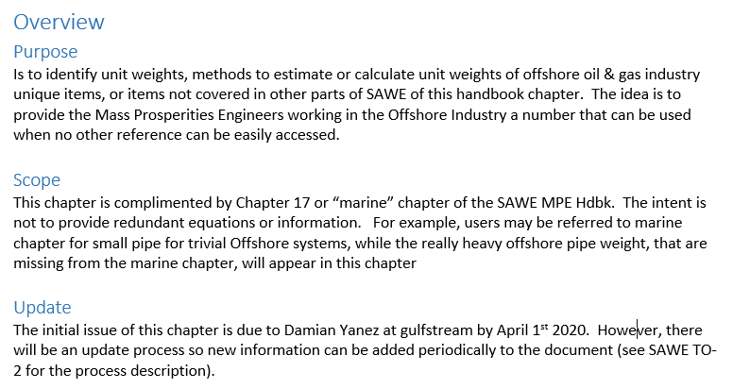
Introduction – SAWE Handbook Updates

Slide 3

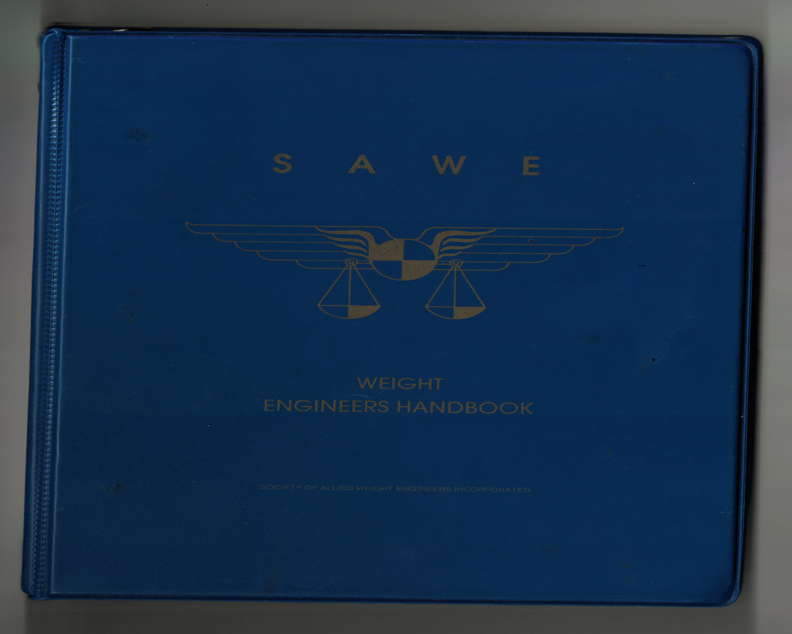
What is the SAWE Weight Engineer’s Handbook?
current
online
version
personal
version
(1986)

Slide 4
What is in the SAWE Handbook?
Conversion Factors and Standard Units
Misc. Data – Log/Trig functions
Section Properties of Plane Areas and 3D shapes
Discussion of Various Integration Methods (area under a curve)
Material Properties of Propellants/Elements/Metals/Alloys/Composites
Coatings/Plastics/Rubbers/Fluids/Gases/Wood/Wiring/Cable/Fabrics/Bulk Materials
Component Weights (MSP) Manufactured/Misc. Standard Parts

Slide 5
What is in the SAWE Handbook? – Cont.
ENGINEERING TECHNOLOGIES
Aerodynamics
Propulsion
Thermodynamics
Power Systems
Structure
Hydrostatics
Flight Mechanics
Communications
Mathematics
Inertia Analysis
Crew Systems
Miscellaneous
DOD Designations
Land Vehicle Industry
Ship Building Industry
Marine
Offshore

Slide 6
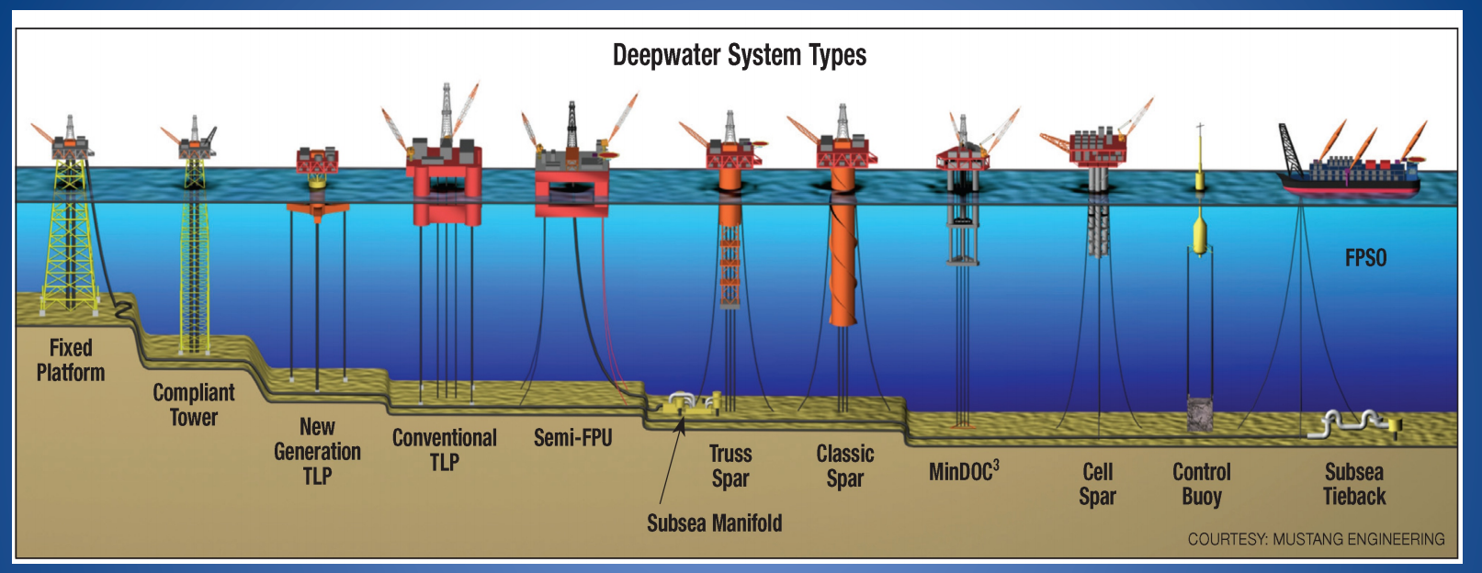
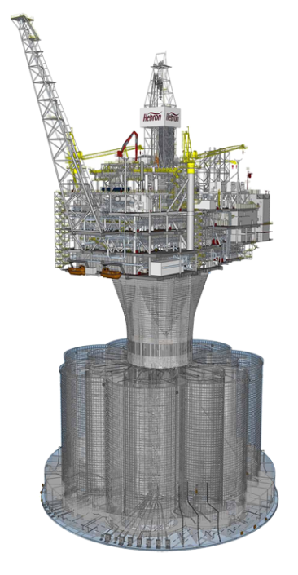
Deepwater Production Systems
Tension Leg Platforms
Compliant Towers
Semi-Submersibles
Gravity - Based
Jackets
SPARs
FPSOs
Buoys

Slide 7
What Information needs to be
in the Handbook?

Slide 8
What Information is a Weight Control Engineer concerned about?

Slide 9
What Information is a Weight Control Engineer concerned about?
DESIGN
OPERATIONS
ENGINEERING
CONSTRUCTION

Slide 10
What Information is a Weight Control Engineer concerned about?
DESIGN
OPERATIONS
ENGINEERING
CONSTRUCTION
*Exempt Weights
*Non-Exempt Weights
*2% weight limit
*10% weight limit
*VCG impacts
*Penalties
*MOC/Warranty/Upgrades
*Facilities Weight Estimate
*Substructure Weight Estimate
*Vertical CoG
*Stability Margins
*Budget Weight
*Discipline Estimates
*Allowances
*Reserves
*Reporting Format
*ISO STD
*Loading Conditions
*Module Weights
*Weighed Weights
*Lifting
*MOC Process
*Actuals vs Budgets
*Inclining
*Final Weight Report

Slide 11
What Information needs to be
in the Handbook?
Unit Weights of Materials
Steel Structural Shapes
UK shapes
Euro Shapes
Large Diameter Pipe
Unit Weights of Equipment
Drilling
Production
Platform
Unit Weights – Compartment Density
Hull Production Modules
Drilling Modules
Mooring System
Unit Weights of Operating Loads
Unit Weights of Components
Stairs
Grating
Handrails
Calculation Methods
Appurtenances
Anodes
Marine Growth
Ice Accumulation
Allowances
Tolerances

Slide 12
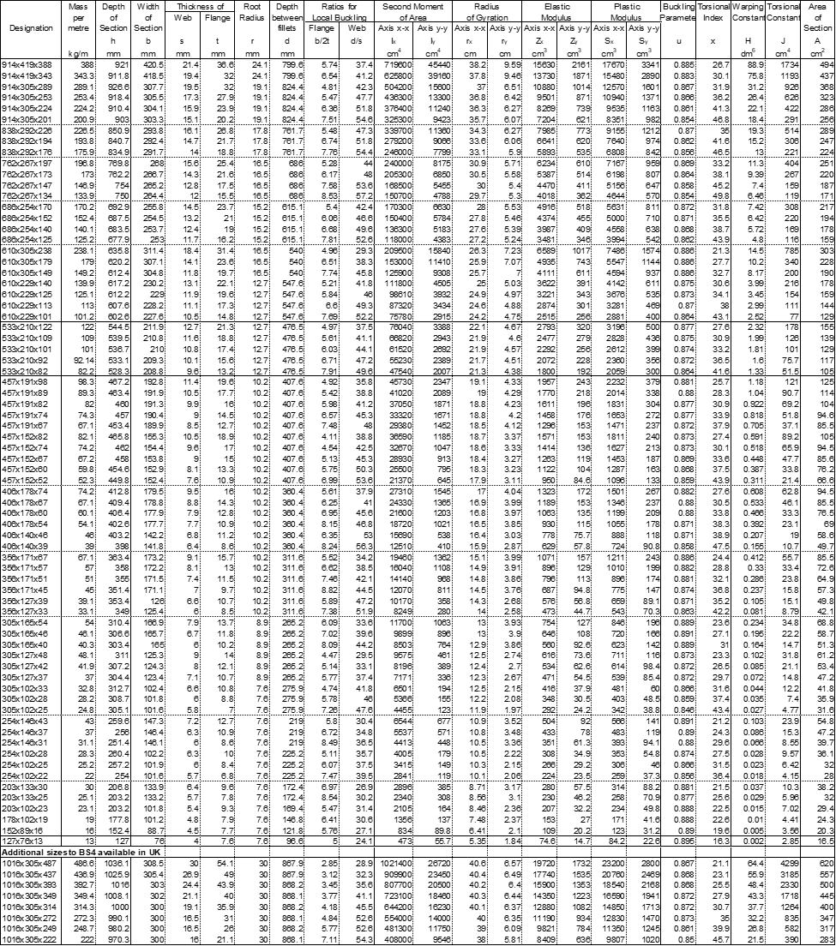
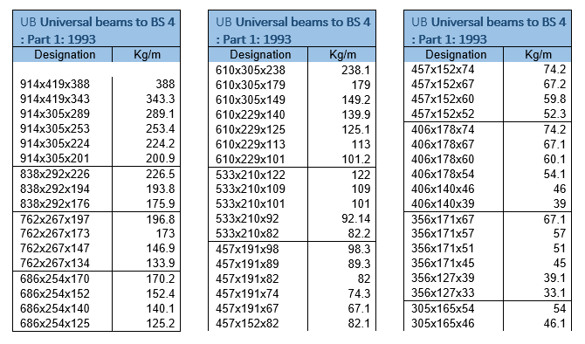
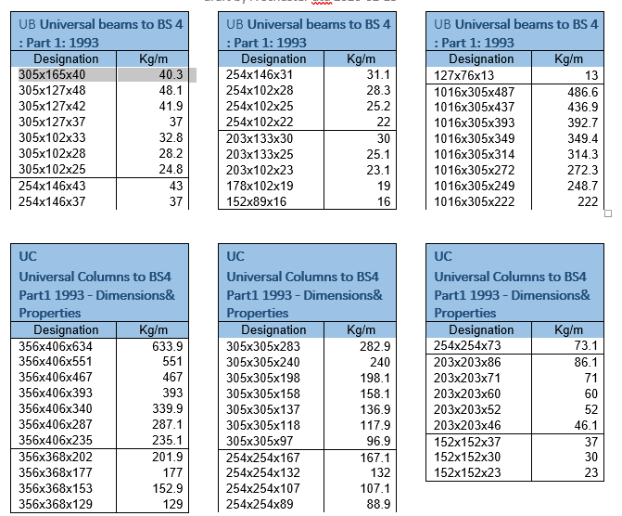
Ideas in work – Unit Weights
What items would be most useful?
What items are most needed?
What items would be most valuable?

Slide 13
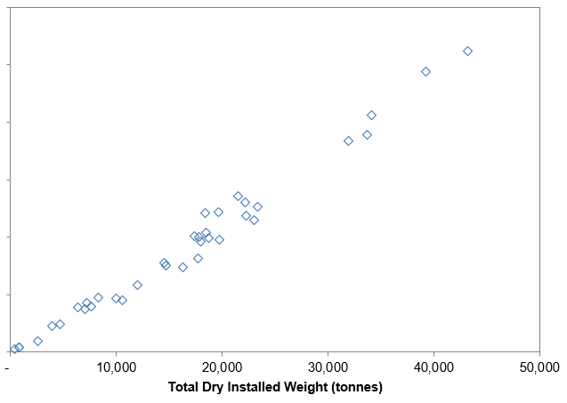
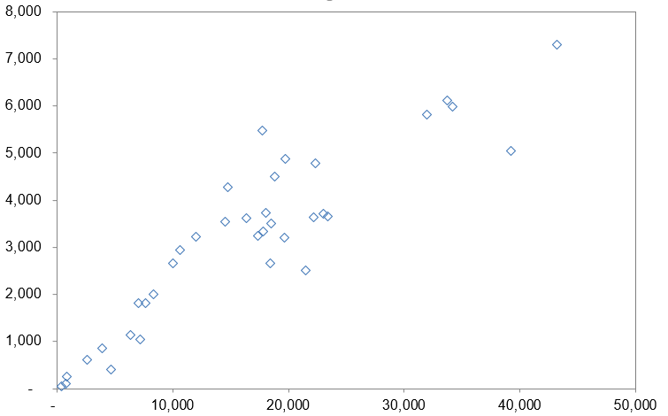
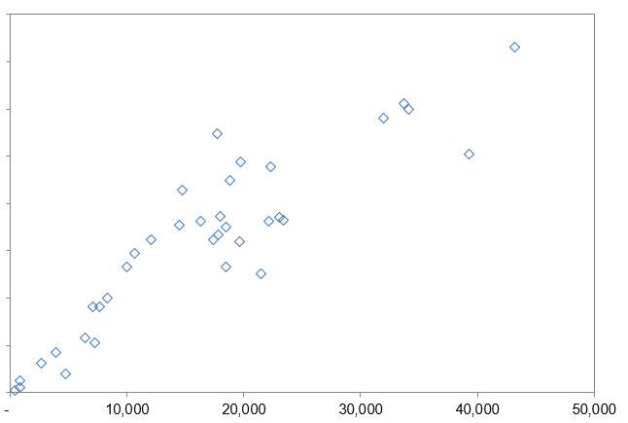
Ideas in Work – Design/Sizing
Substructure Weight
Throughput
Topsides Weight
Topsides Weight
Develop a Formulation for Topsides Weight as a Function of key parameters;
Throughput, Redundancy, Sparing, Viscosity, Oil Properties, Re-Injection, Pressures, Transport, Pumping, Power, POB, Regional Factors, etc.
Deck Area
Topsides Weight

Slide 14
Interactive Portion
A
Name
What specific weight information would you like to see in the SAWE Handbook?

Slide 15
Interactive Portion
B
What generic weight engineering information do you have that could be a worthwhile addition to the SAWE Handbook?

Slide 16
Interactive Portion
C
What is the lightest (least dense), incompressible liquid you can think of ?

Slide 17
Contact Information
Adam Richards
adam.richards@akersolutions.com
713-332-6486

