Slide 1
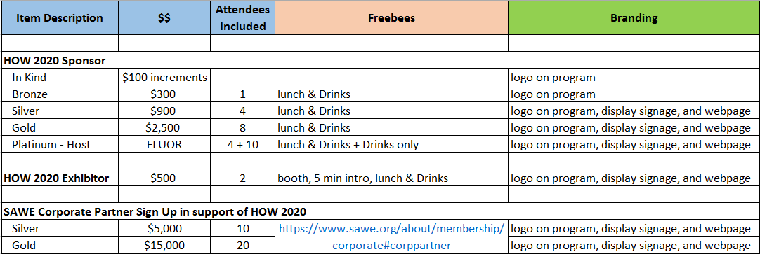
SAWE Houston Offshore Workshop 2020 Sponsor, Exhibitor, Corporate Partner Benefits

