Slide 1
ABS Rules & Guides
Joe Rousseau| 6 Mar 2020
Houston

Slide 2
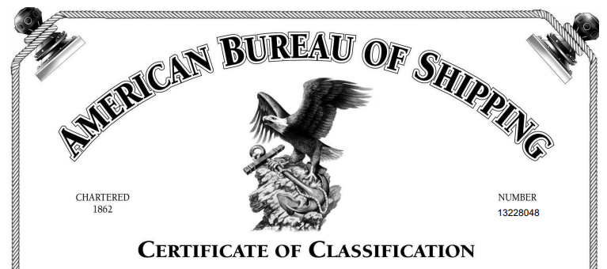
Class Notations
“This is to certify that the above has been surveyed in accordance with the Rules of this Bureau and entered in the Record with the Class:
A1, Drillship, , DPS-3, ACCU, CDS
Additional Notations
CRC, GP, NBLES, PMP, SH-DLA, UWILD”

Slide 3
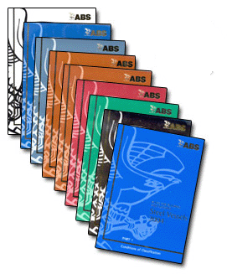
Definitions
Rules
Requirements for classification and issuance of certificates and notations
Formal revision process
Guides
New classification requirements recently introduced – effectively, preliminary Rules; requirements for optional notations; requirements under frequent revision
Guidance Notes
Non-binding guidance. Industry best practices and information in support of sound judgment of the user

Slide 4
Rule Changes
Rule Change Proposal: ABS, industry, regulators
Internal review
Regional & Special Committee review
TOTC/TMTC review
Rules Committee review
Publishing
30 Sep
30 Nov
28 Feb
10 May
30 May
1 Jul /
1 Jan

Slide 5
ABS Committee Structure
ABS Rules Committee
Approval
The Marine Technical Committee
The Offshore Technical Committee
Senior Advisory
REGIONAL COMMITTEES
Americas Europe Pacific Greater China
Americas -Europe -Japan -China
-Hellenic -Korea -Taiwan
-SEAME -Hong Kong
Advisory
Marine Special Committees
Ship Operations
Great Lakes
Western Rivers
Shared Special Committees
Small Vessels
Materials & Welding
Underwater Systems
Offshore Special Committees
Mobile Offshore Units
Offshore Production
ABS Technical Committee Structure
TWZ-008-02-P01 Attachment A – Revision 3 Page 1 of 1

Slide 6
Guide Changes
Guide Change Proposal: ABS, industry, regulators
Internal review & invited industry review
Rules Committee review
Publishing

Slide 7
Thank You
www.eagle.org

