Slide 1

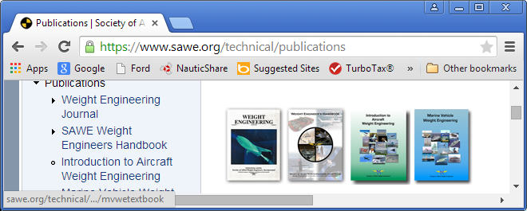

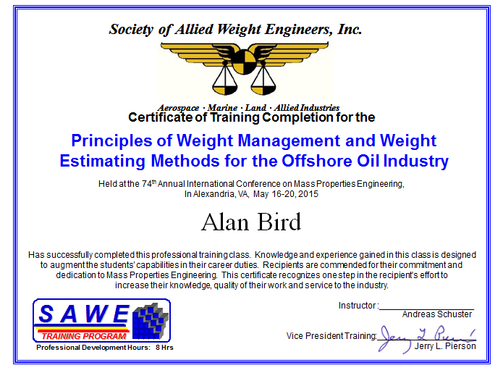

Overview
Developed since 2009
Offshore Training Class
RP O-1 Terminology
RP O-2 Coordinate Sys
RP O-3 Weighing
To Be Done
RP O-5 WBS
RP O-6 Uncertainty & Risk
Papers RPs Text Books Training Better MPEs

Slide 2
SAWE Process for ANSI Standards & SAWE RP
& all other SAWE Documents

Slide 3
Backup

Slide 4
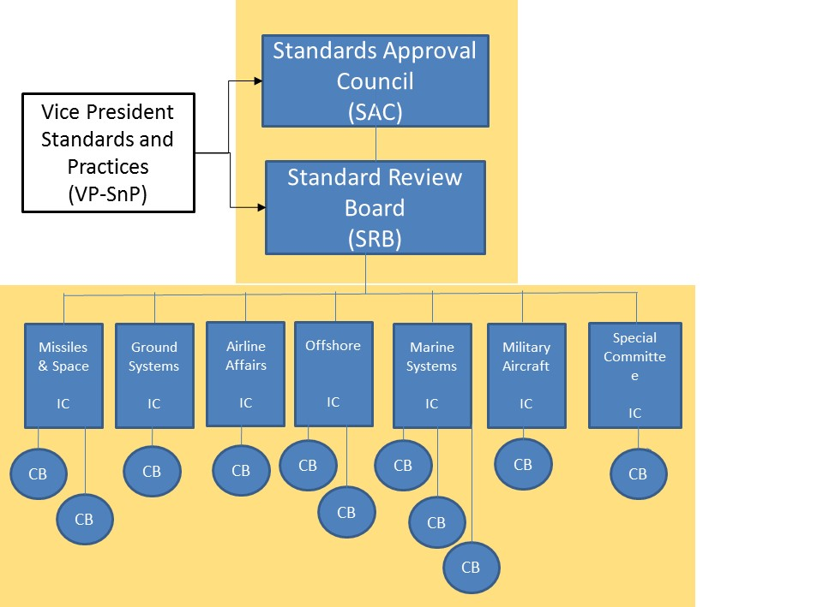
Who
Corporate Partners & SAWE Pres, VP’s Tech, Training & SnP
Deputy VP SnP - SRB
IC Chairs (ex ANSI Comte)
Deputy VPs
SRB
Jeff C
Publications
Stacie M
Data Mgmt
OPEN
Meeting today
Consensus Bodies
RP Development & Maintenance
Short Term committees

Slide 5
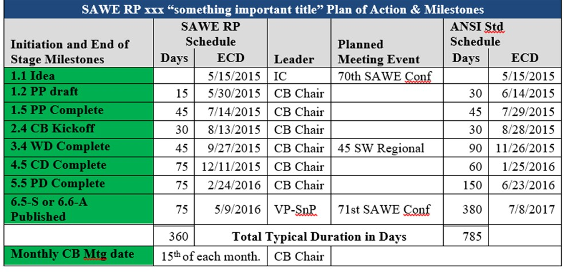
Default Schedules

Slide 6
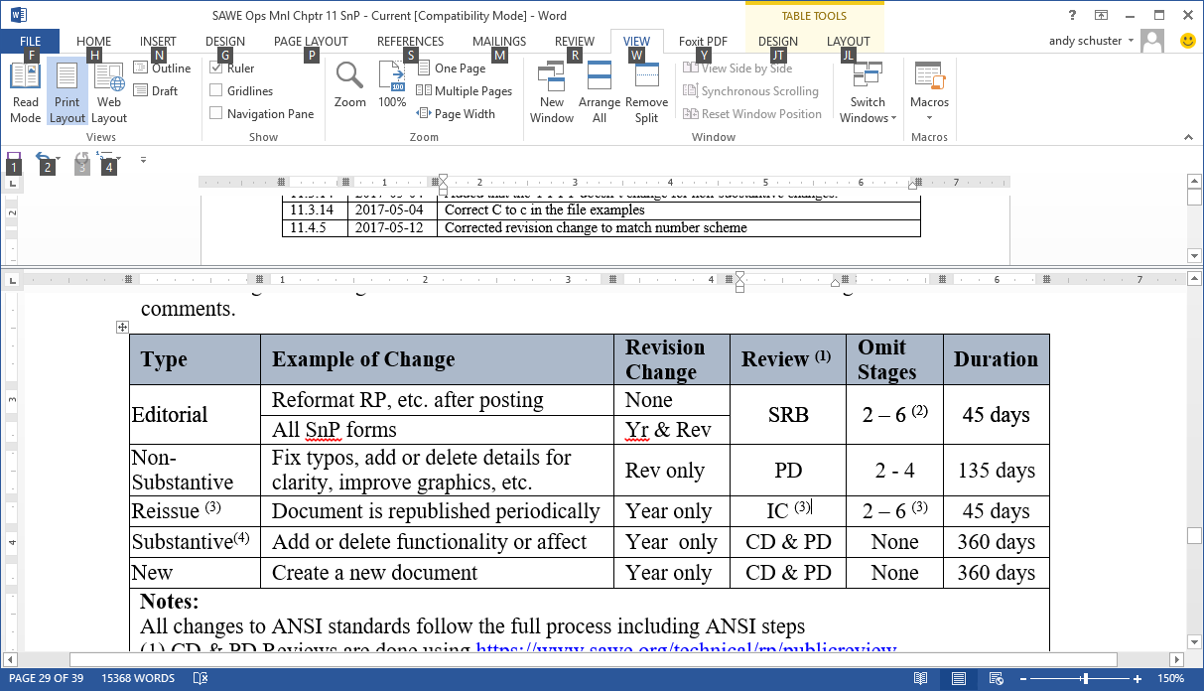
Tailored Schedules

Slide 7
Project Proposal
Key Information 1. Proposed title of RP or Project
2. Proposed chair
3. Scope of Work
4. Why is it needed
5. Identify the stakeholders
6. Identify the Audience or Users
7. Plan of Action and Milestones 8. Functional Requirements
Additional Information
9. Survey of similar work
10. Liaisons & MOUs
11. Membership
12. Additional Comments
13. Submitter Information

Slide 8
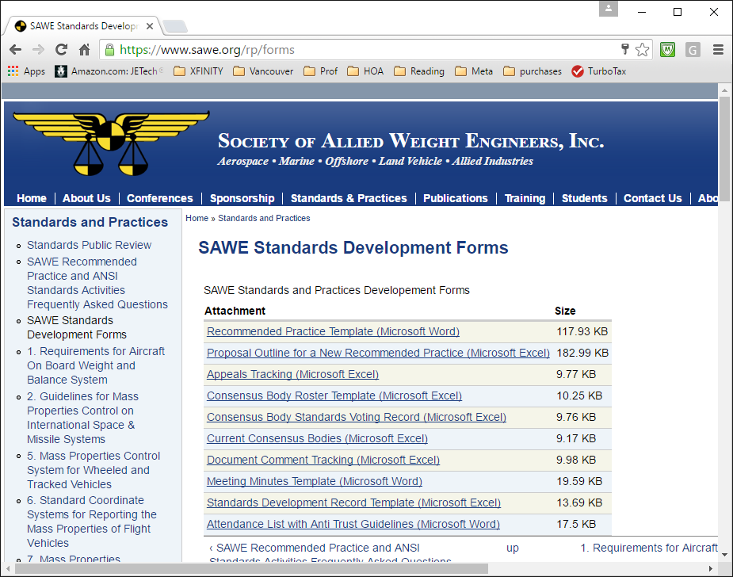
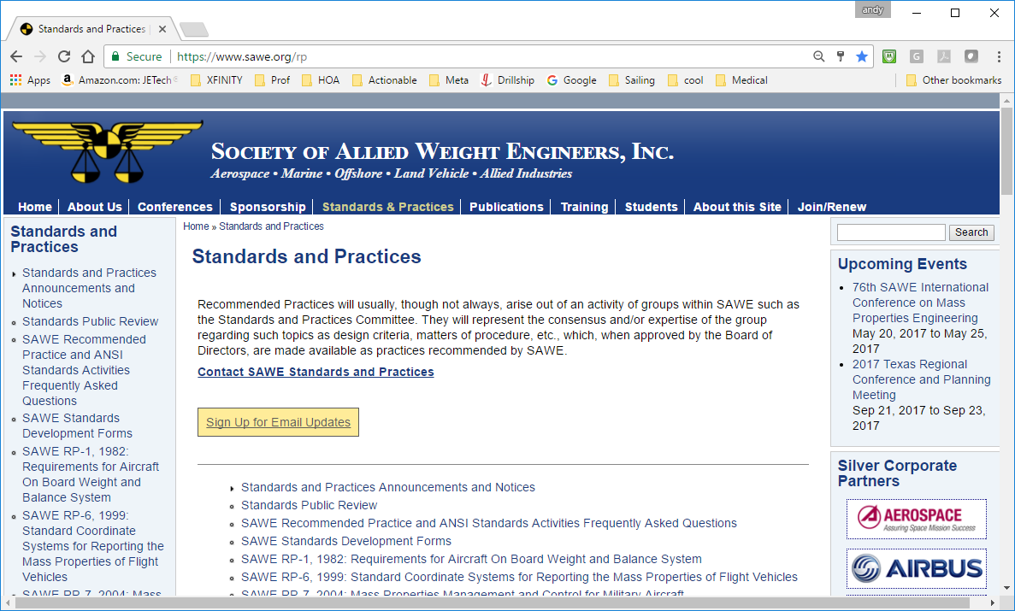
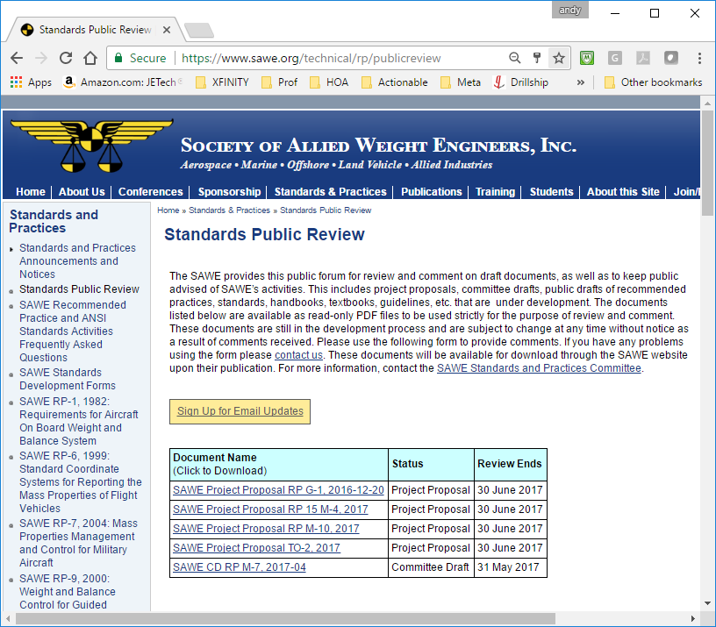
Tools
Web Site
Published RPs
Announcements, FAQs
Standards Public Review
Forms on line
SAWE Inc
SAWE Free Conference Call
Operations Manual Chapter
Go-To-Meeting
Group Office
Sages & SAWE Fellows
SRB
Deputy VPs
Mentors

Slide 9
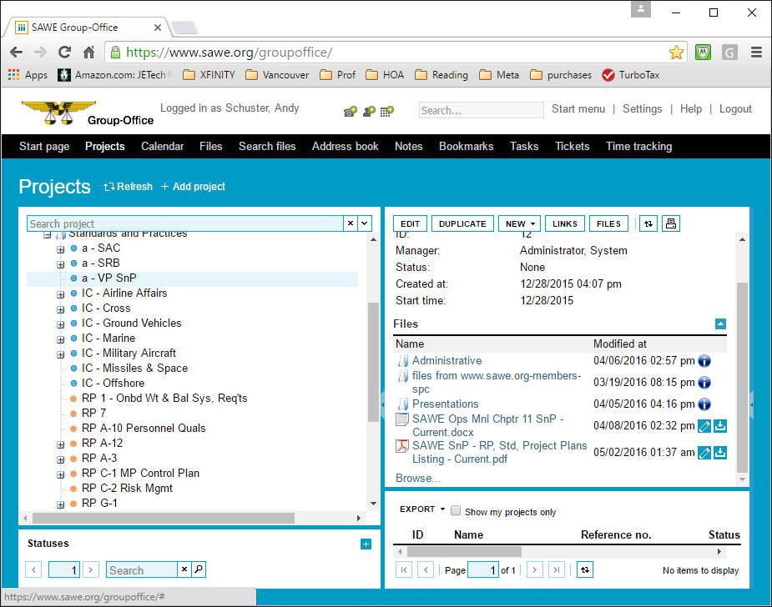
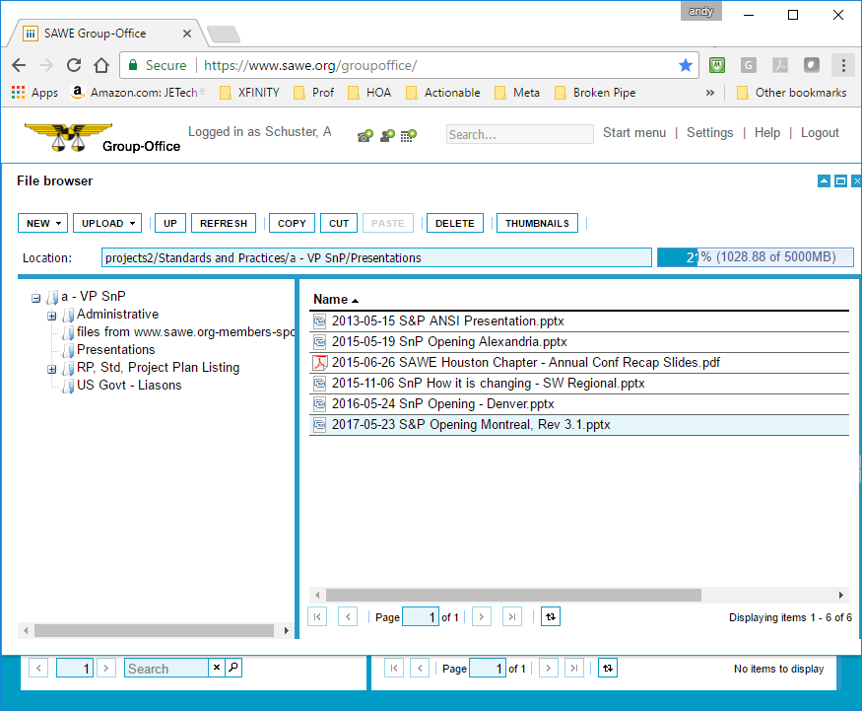
Group Office

Slide 10
Roles of ICs & CBs
Industry Committees
Discuss Requirements for RPs
Define Projects and prepare proposal
Encourage Papers to be presented
IC Chair (3 elected)
Plan Meetings (Annual & Regionals)
Attend SRB Mtgs (1st Wed of month)
Monitor RP Development.
Consensus Bodies (5+ members)
Execute the Project Proposal
SAC (Standards Approval Council)
Provide direction
Assure objectives are met
SRB (Standards Review Board)
Quality of RPs
Decide how to get it done
Info sharing btw committees

